Slide 1



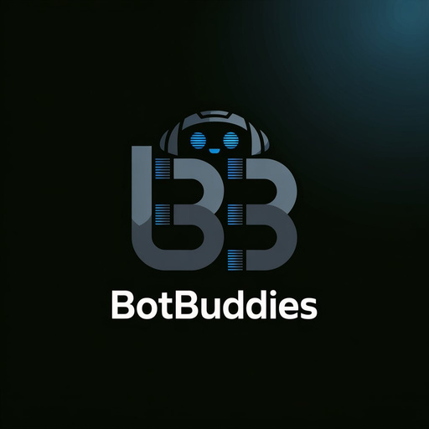

BotBuddies Presents Chhatrapati Sambhajinagar’s Biggest Tech Hackathon INNOHACK 2025
Team Name: Solo Dev
Team Members: Pushpak Mahendra Jaiswal
Institution: CSMSS Chh. Shahu College of Enginnering

Slide 2

Problem Statement
Problem Statement ID & Title: 15. Open Innovation(Agentic Ai Suite)
Brief Description of the challenge:
Modern users face challenges like resume filtering, fake news, insecure code, and scheduling inefficiencies. Manual solutions are slow, error-prone, and lack intelligence. The Agentic AI Suite tackles these by unifying AI-driven tools into one platform to automate and enhance job matching, news verification, secure coding, document Q&A, and professional communication.
Why this problem matters:
Hiring bottlenecks slow down recruitment and reduce the chances of finding ideal candidates.
Fake news can mislead the public, influencing opinions, actions, and even national outcomes.
Insecure code in software systems leads to vulnerabilities, data breaches, and financial loss.
Manual Q&A & scheduling wastes time and reduces productivity in professional environments.
Agentic AI Suite empowers users to make informed, efficient, and secure decisions—automatically and intelligently.

Slide 3

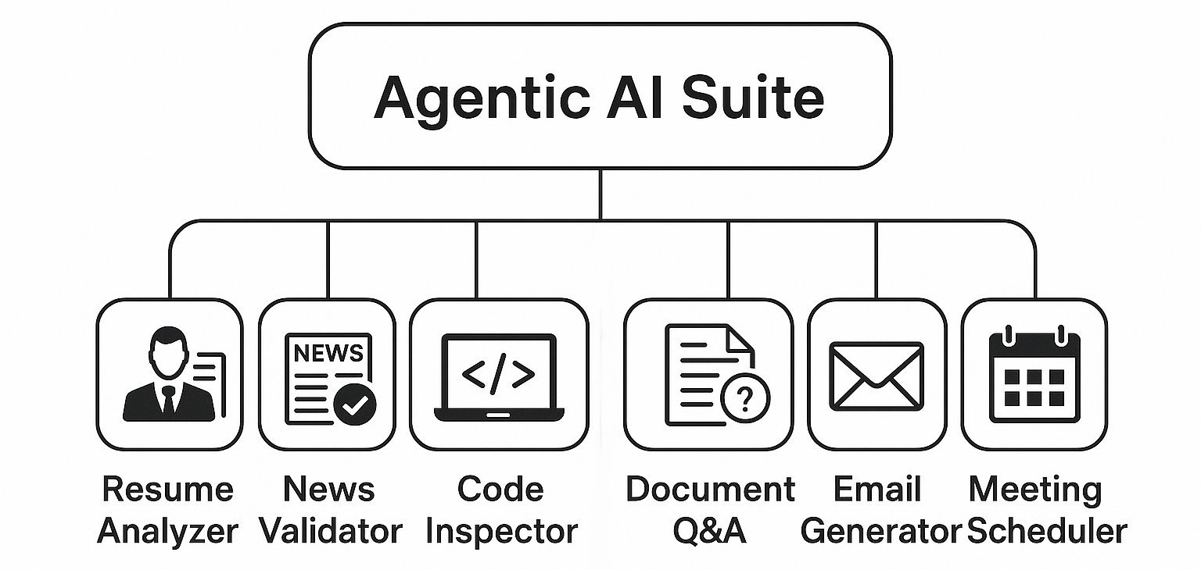
Proposed Solution
Describe your unique idea/solution:
The Agentic AI Suite is an all-in-one AI-powered platform featuring six specialized agents that solve key real-world problems across recruitment, media, software development, documentation, and professional communication. Unlike standalone tools, this suite leverages multi-agent collaboration, natural language understanding, and real-time intelligence—offering a cohesive, automated experience.
Key features or approach:
✅ Resume Analyzer: Compares job descriptions with resumes using semantic and keyword matching.
📰 News Validator: Verifies news authenticity by cross-checking with real-time web sources.
🔍 Code Inspector: Detects logic errors, vulnerabilities, and security issues in code files.
📄 Document Q&A: Provides instant answers to queries based on uploaded PDFs or documents.
✉️ Email Generator: Drafts context-aware professional emails using AI.
📅 Meeting Scheduler: Suggests, schedules, and manages meetings automatically through natural language inputs.
Add diagrams/sketches if needed:

Slide 4

Tech Stack
Programming Languages:
Python
TypeScript (React Native)
Frameworks / Libraries:
Streamlit – Web Interface
React Native – Android App (via WebView)
GoogleSearch Library – Real-time news validation
Structured Outputs (Ollama) – Clean data extraction and formatting
Tools / Platforms Used:
Ollama – Running local LLMs
Gemma 3 (4B for development, 12B for production output) – Core reasoning and inference
PyWebView – Desktop App Wrapper
Android WebView – Mobile App Deployment
ChromaDB – Vector Database

Slide 5

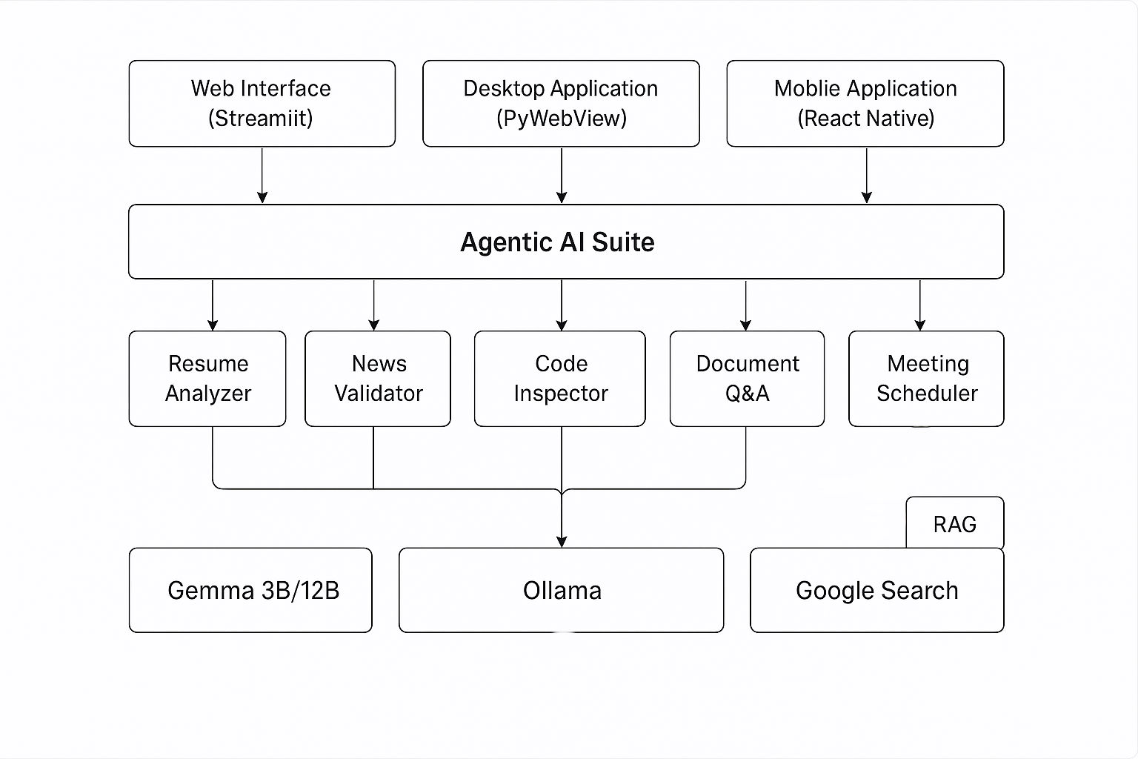
System Architecture / Workflow
Include a flowchart or architecture diagram:
Explain how components interact: Users access the suite via web, desktop, or mobile. Their input is routed to one of six agents (like Resume Analyzer or News Validator). Each agent uses Ollama with Gemma 3B/12B models and RAG (for live info via Google Search) to process data. Results are quickly returned to the user through the same interface.

Slide 6

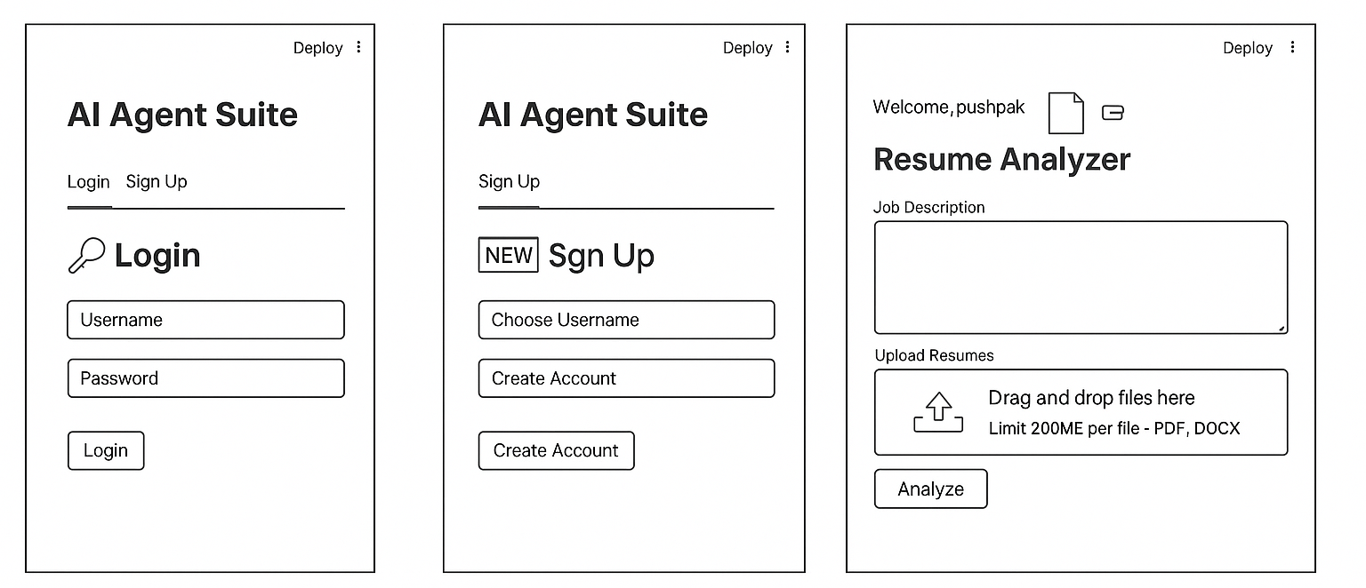
Prototype / Screenshots

Slide 7

Innovation & Impact
What makes your idea unique?
A unified AI agent suite combining resume analysis, code review, fact-checking, document Q&A, email writing, and meeting scheduling in one platform.
Expected real-world impact:
Boosts productivity, saves time, ensures accurate info, and simplifies complex tasks for professionals.
Future scope or scalability:
Easily extendable to new domains, supports enterprise use, and can integrate with tools like calendars, CRMs, and mobile apps.

Slide 8

Team & Roles
Pushpak M. Jaiswal
Role: Team of One
Responsibilities: From coding to coffee breaks — built it all, debugged it all, stressed through it all.
Contact (Optional)
Email: pushpakmjaiswal@gmail.com
GitHub: https://github.com/PUSHPAK-JAISWAL
LinkedIn: www.linkedin.com/in/pushpak-jaiswal

